Slide 1
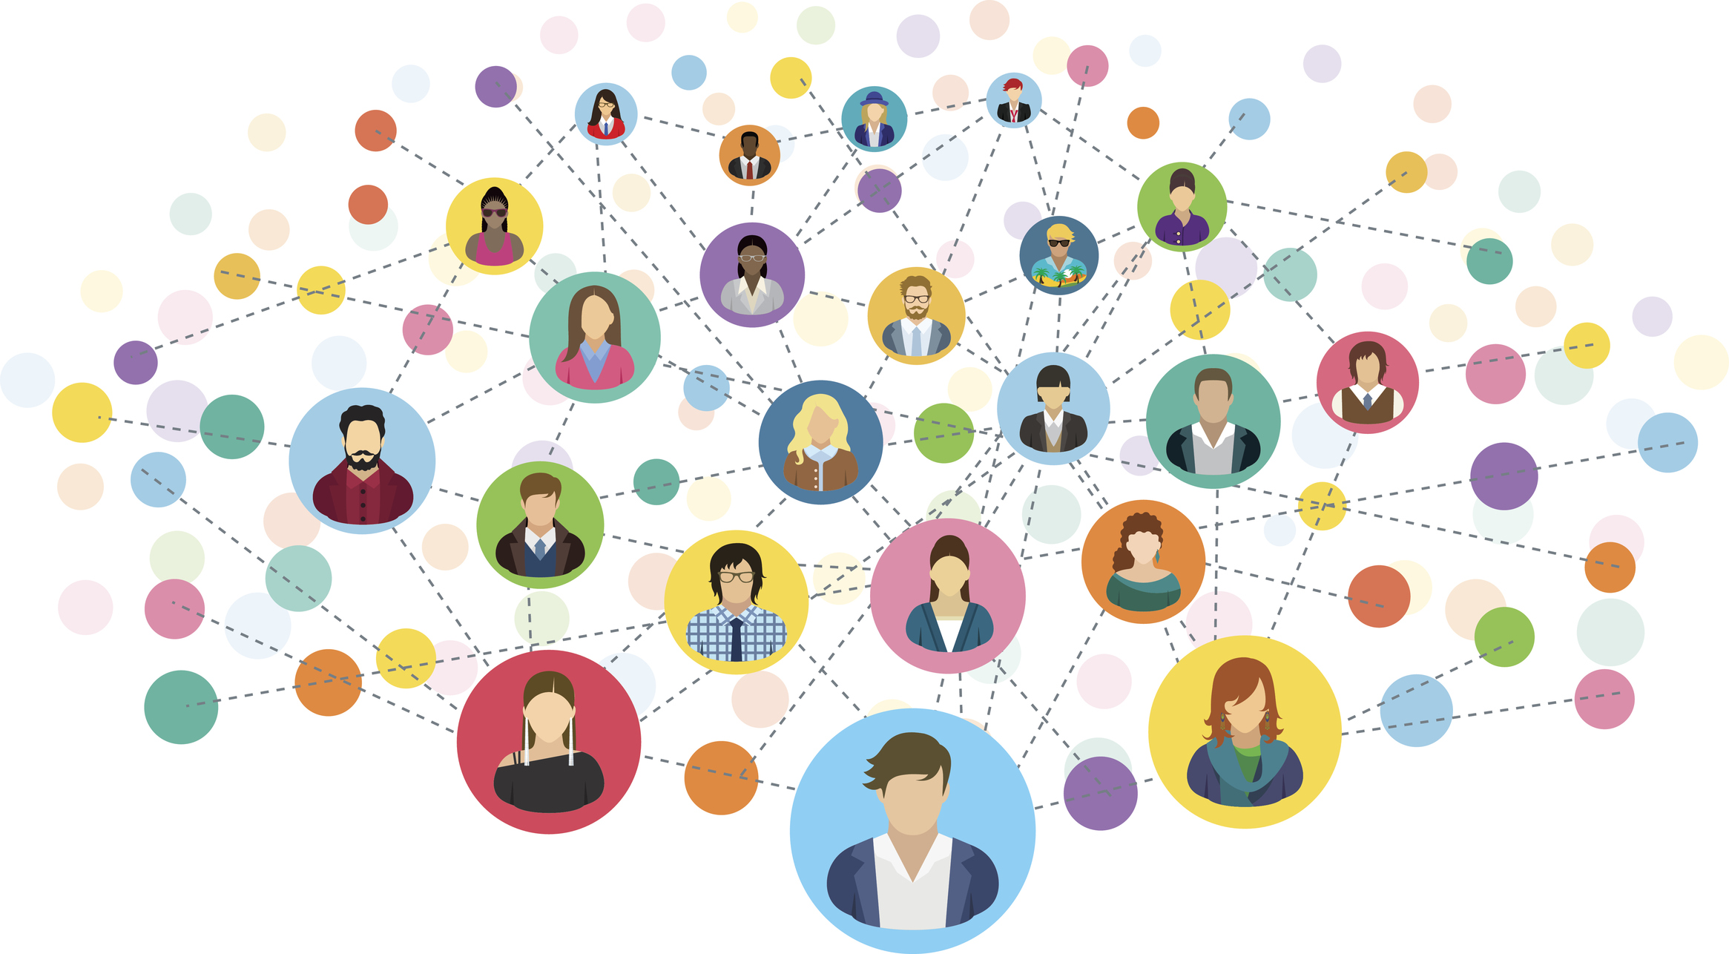

From Communities to Crowds: Quantifying the subjective An overview
Sagar Joglekar, Ph.D. Candidate, Computer Science
@SagarJoglekar

Slide 2






Notes:
Little bit of an introduction.

Slide 3
Can quantifying the interactions that are driven by our subjective perceptions, help us design impactful interventions for our on-line and offline lives?

Slide 4

What is the subjective?
Impacted by personal affects, feelings and opinions.
Subject to one’s perception of the world
Grounded in individual’s or community’s context.

Slide 5

Communities and Crowds on the Web
Communities
Crowds
Content
Users interact with other users
Users interact with content

Slide 6
WISDOM
REASONING
Cognition
KNOWLEDGE
METRICS
With Meaning
INFORMATION
ABSTRACTIONS
With Purpose
DATA
RAW/SIGNALS

Slide 7
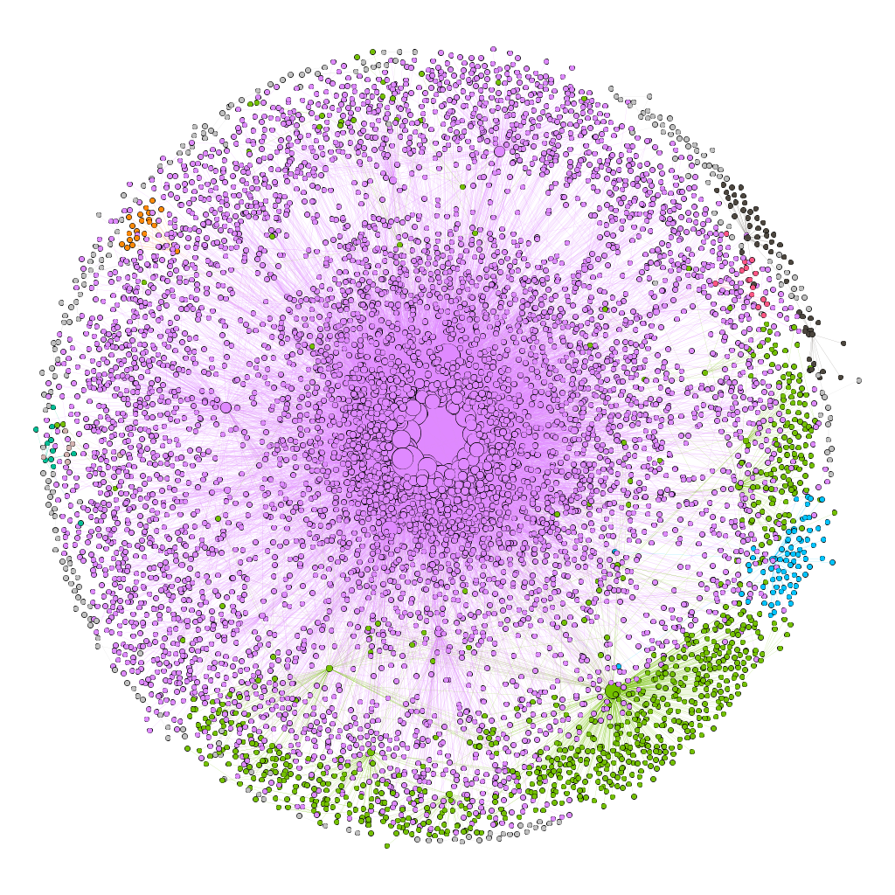
Part 1: From communities
Users interact with other users
Macroscopic Paradigm
Mesoscopic Paradigm

Slide 8
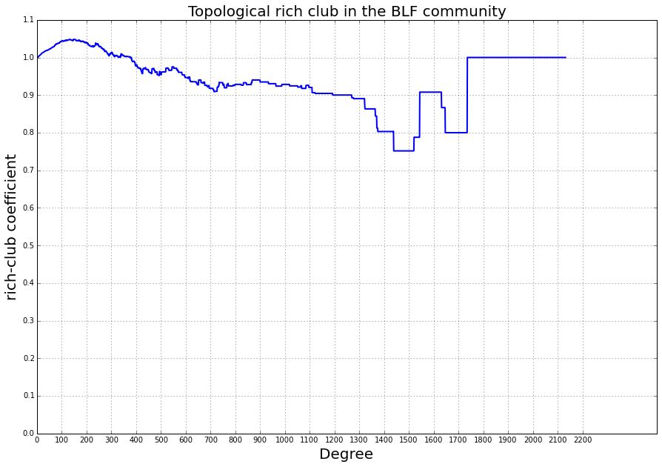
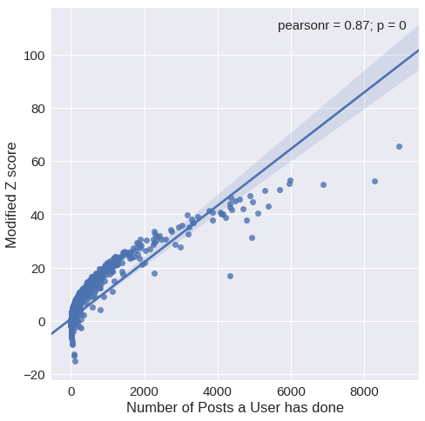

Slide 9
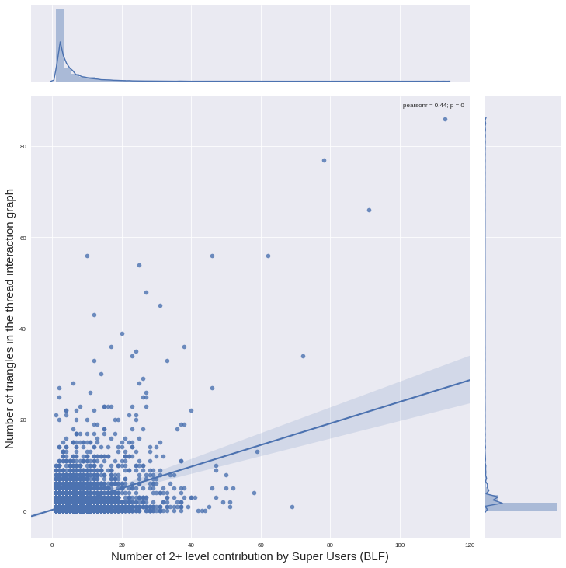

Slide 11
Takeaways
Supportive groups exhibit anti-rich behavior
Supportive users evolve over time
Supportive users bridge triadic closures
Supportive conversations are user (OP) centric
Supportive conversations exhibit urgency, low digression and topical alignment
A new technique to perform triadic census around user roles

Slide 12
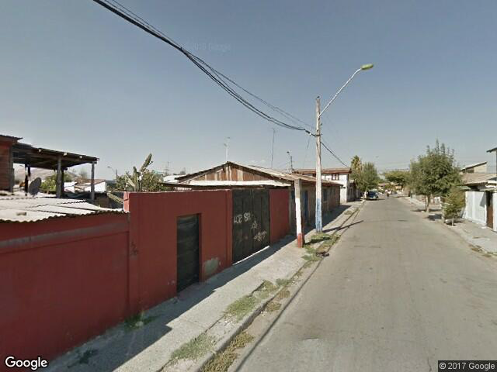
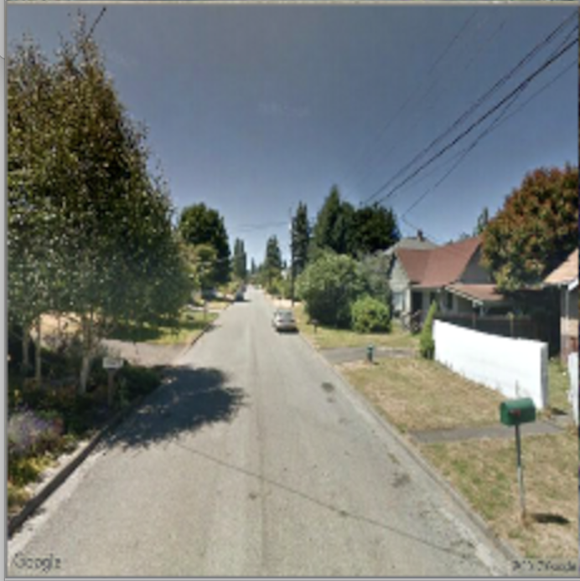
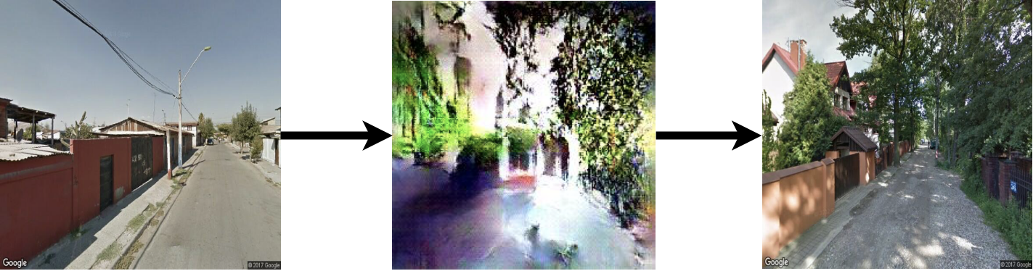
Part 2: From crowds
Content
Users interact with content

Slide 13
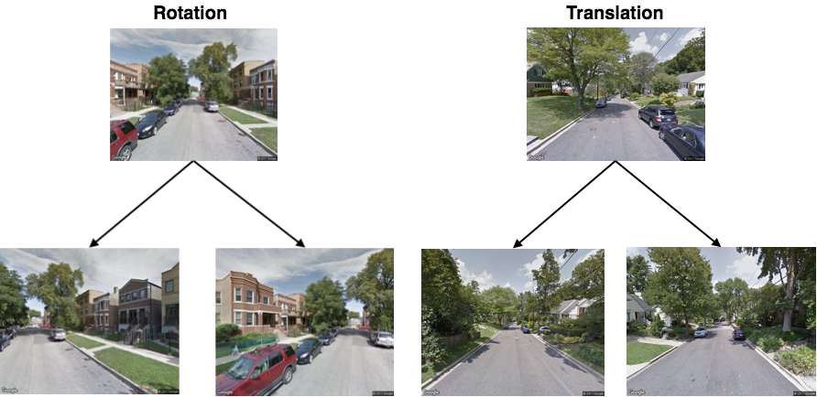
Data Augmentation

Slide 14
Classifier + GAN

Slide 15
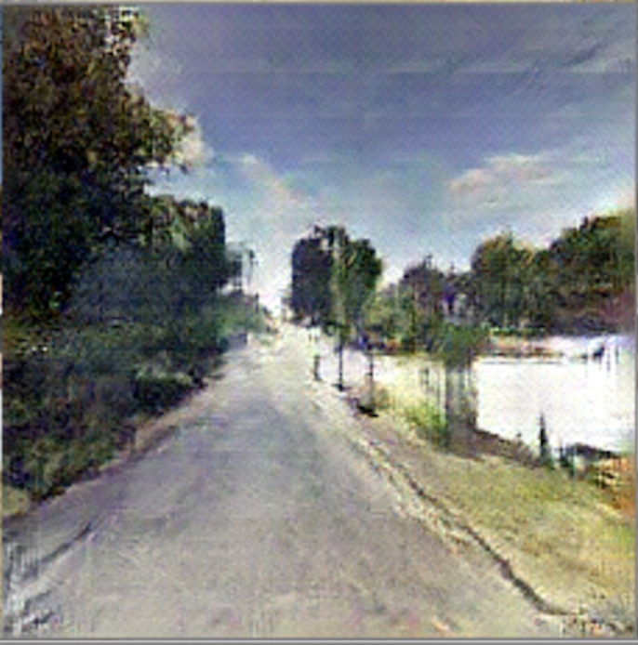
GAN abstraction Examples

Slide 16
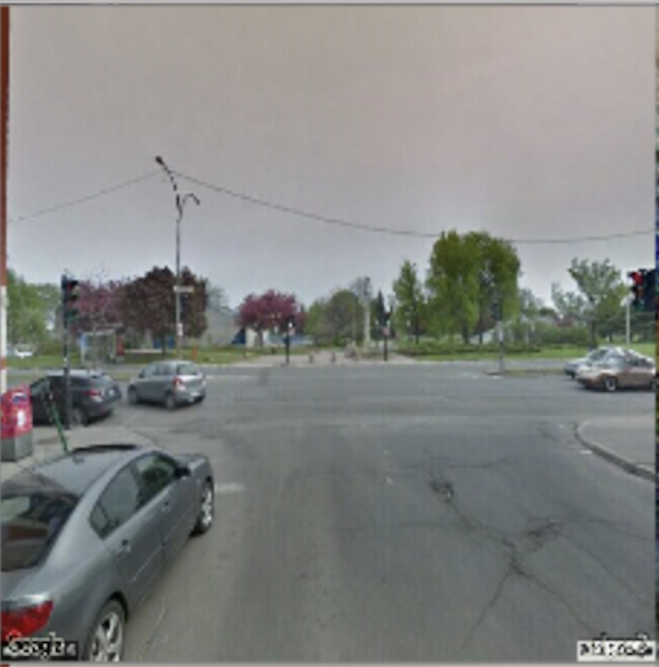
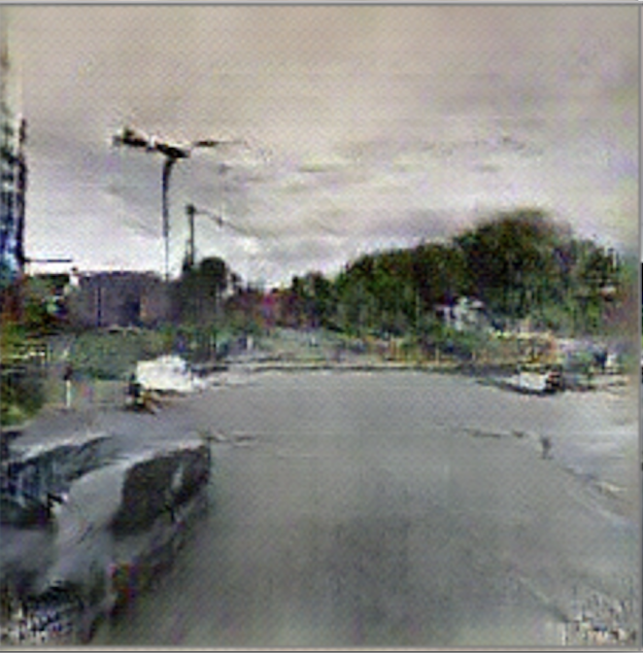
GAN abstraction Examples

Slide 17
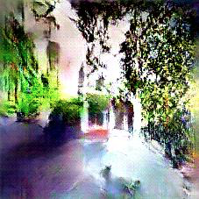
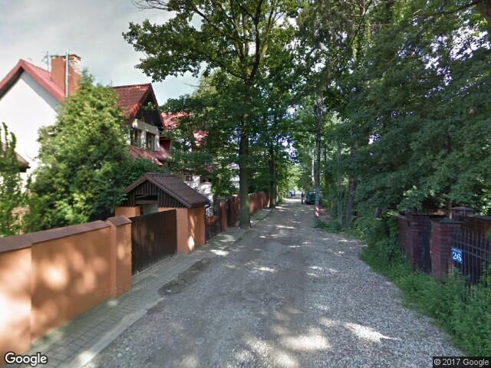
Transformation Examples:
Original
Template Transform
Beautified
Notes:
Retrieval is done using some deep network
We try overlaying the template on the original to give it an additive feel, but did not succeed without corrupting the original

Slide 18
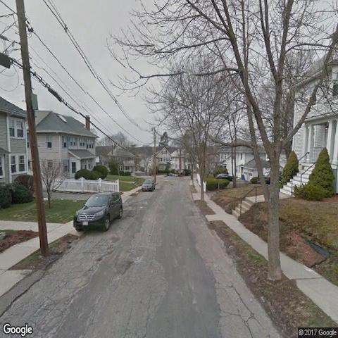
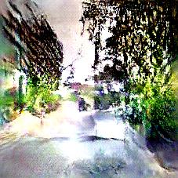
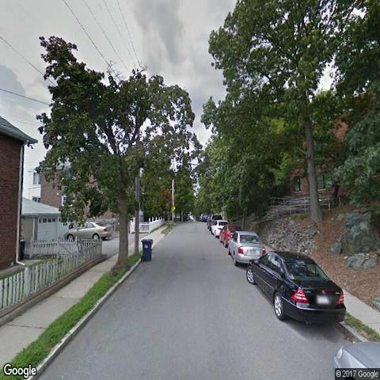
Transformation Examples:
Original
Template Transform
Beautified
Notes:
Retrieval is done using some deep network
We try overlaying the template on the original to give it an additive feel, but did not succeed without corrupting the original

Slide 19
Metrics
Green spaces
Computed using SegNet segmentation
Walkability
Computed using PlacesNet scene recognition
Openness
Computed using Sky pixel ratios
Complexity
Computed using Entropy of objects

Slide 20
Takeaways:
Subjective quality of aesthetics can be quantified crowd perceptions
Predictions made by these models align with real humans
Generative models can then capitalize on these models to suggest real world interventions
The suggestions or “Wisdom” learned by the generative models improves real practitioner's understanding of the urban aesthetic

Slide 21
What next ?
Measuring effect of urban environment on health
Walkability deprivation
Natural deprivation
Empathic healthcare
Bio-psycho-social model of health care
Developing pipelines to estimate health outcomes from open data
Quantifying types of support on social networks

Slide 22
Research output:
Joglekar S, Sastry N, Coulson NS, Taylor SJ, Patel A, Duschinsky R, Anand A, Evans MJ, Griffiths CJ, Sheikh A, Panzarasa P. How online communities of people with long-term conditions function and evolve: Network analysis of the structure and dynamics of the asthma UK and British lung foundation online communities. Journal of medical Internet research. 2018;20(7):e238.
Joglekar, S, Redi M, Kauer T, Quercia D, Aiello L , Sastry N "FaceLift: A transparent deep learning framework to beautify urban scenes” To appear in Royal Society Open Science
Joglekar S, Velupillai S, Dutta R , Sastry N "Analysing network structures of conversations in an online suicide support forum " Under Review
Kauer T, Joglekar S, Redi M, Aiello LM, Quercia D. Mapping and Visualizing Deep-Learning Urban Beautification. IEEE computer graphics and applications. 2018 Sep 27;38(5):70-83.
Joglekar S, Sastry N, Redi M. Like at first sight: understanding user engagement with the world of microvideos. In International Conference on Social Informatics 2017 Sep 13 (pp. 237-256). Springer, Cham***.

Slide 23
Thank you
List of Collaborators:
Dr. Miriam Redi
Dr. Daniele Quercia
Dr. Gareth Tyson
Dr. Anna De Simoni
Dr. Luca Aiello
Dr. Pietro Panzarasa
Dr. Sumithra Vellupillai
Dr Rina Dutta
Dr. Peter Young
Aravindh Raman
Tobias Kauer

Slide 24
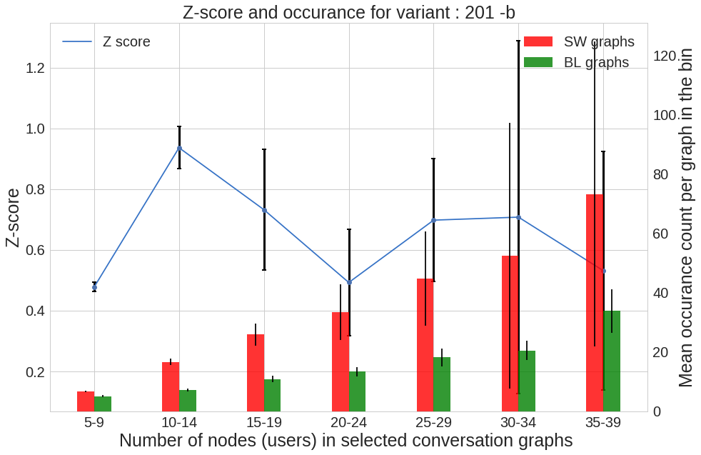
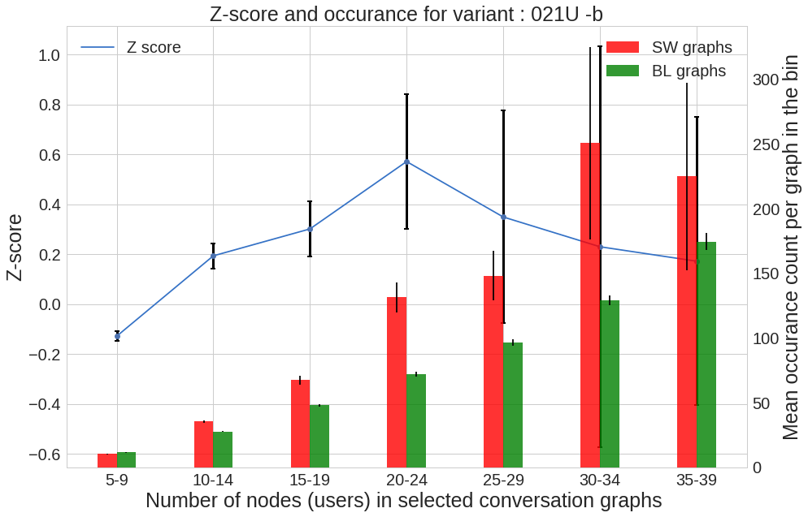
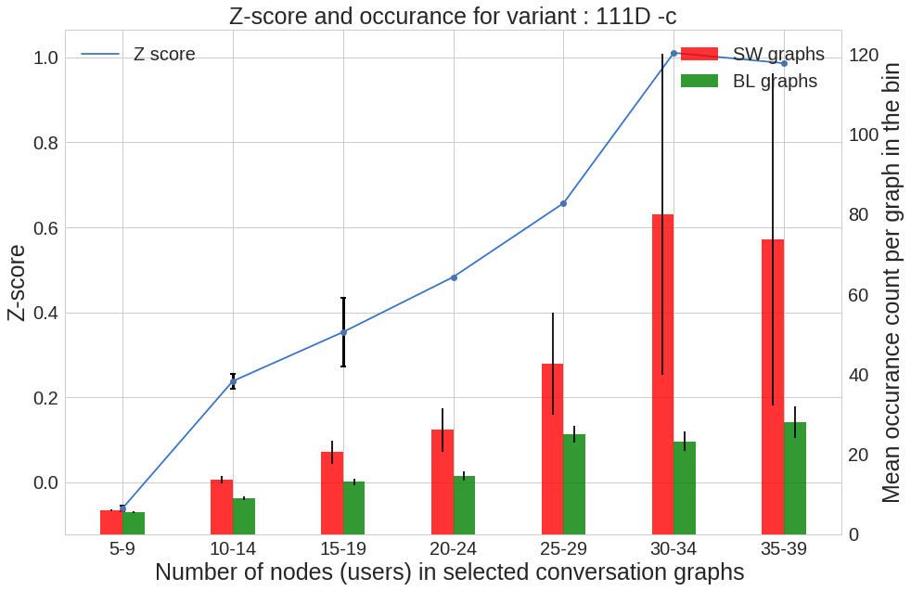
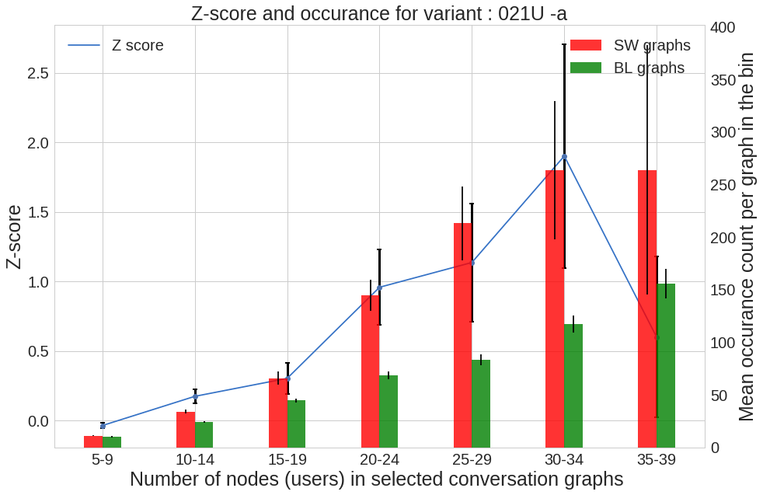
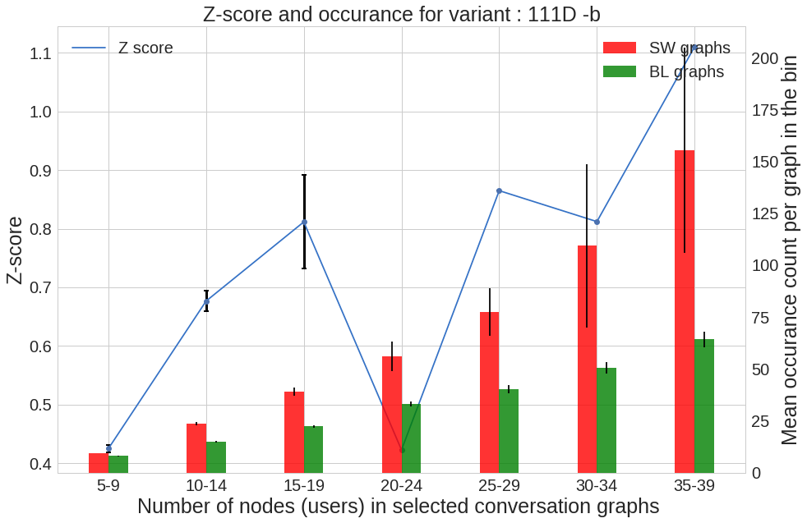
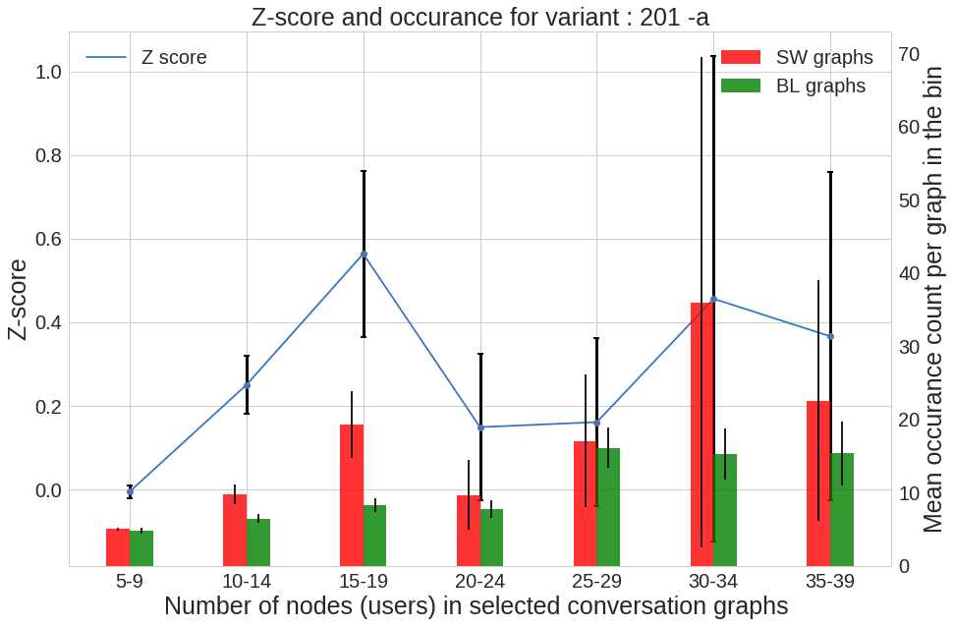

Slide 26
Data
Data:
800k+ posts from British lung foundation group
500k+ posts from suicide watch subreddit
Abstractions:
Global interaction graphs
Thread level user Interaction graphs
Thread level reply graphs

Slide 27
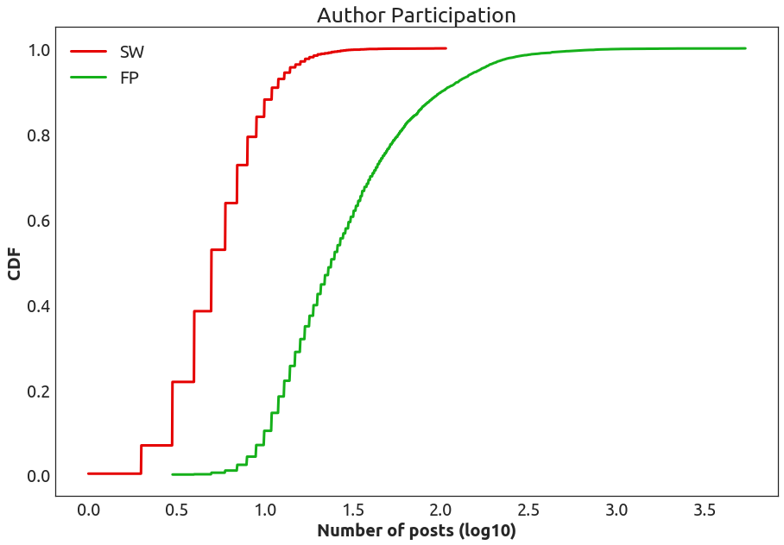
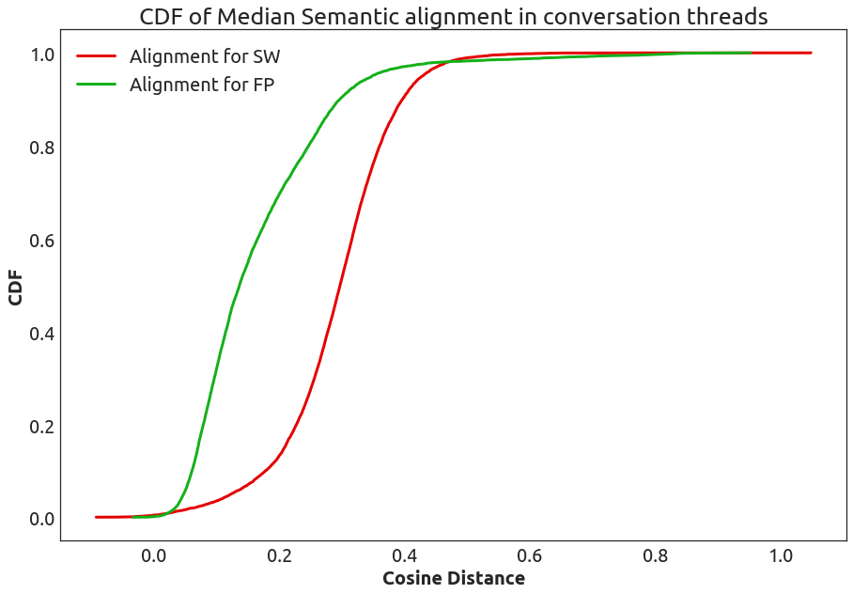
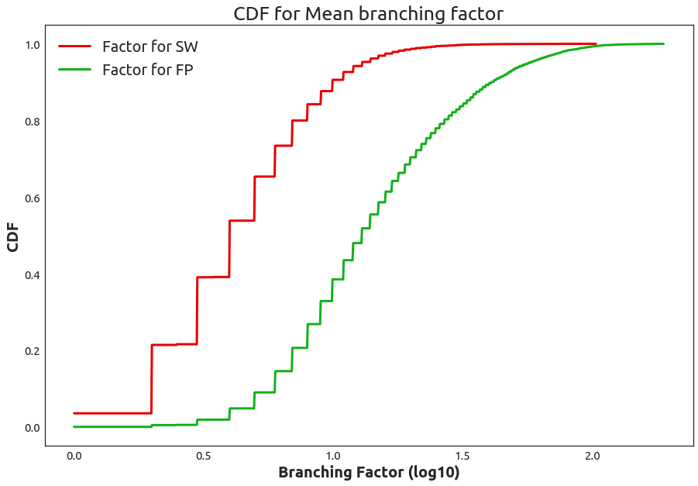
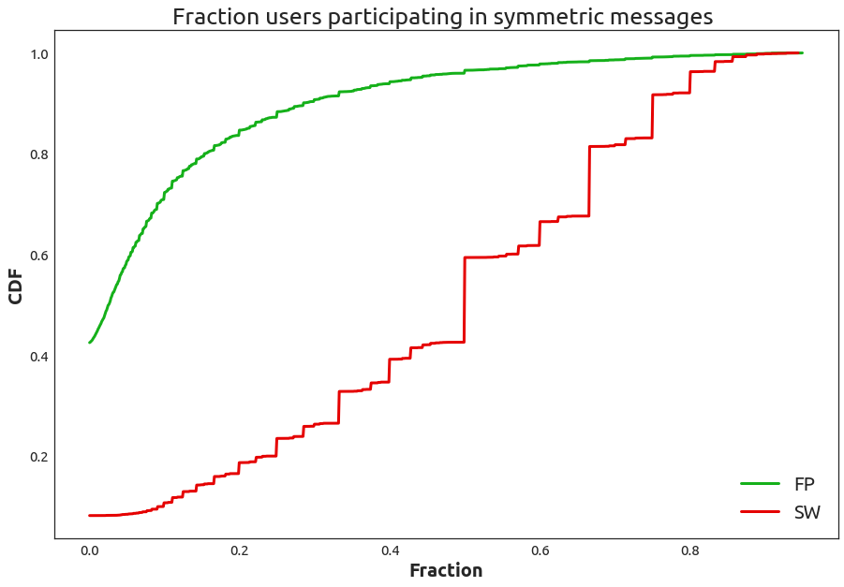
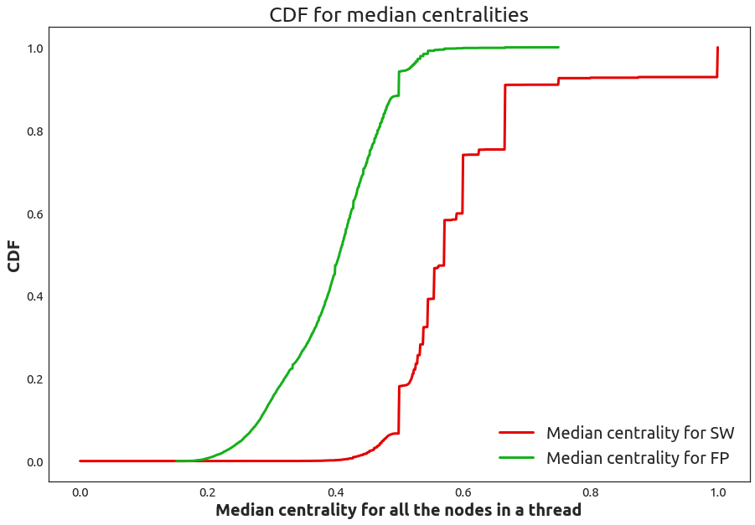
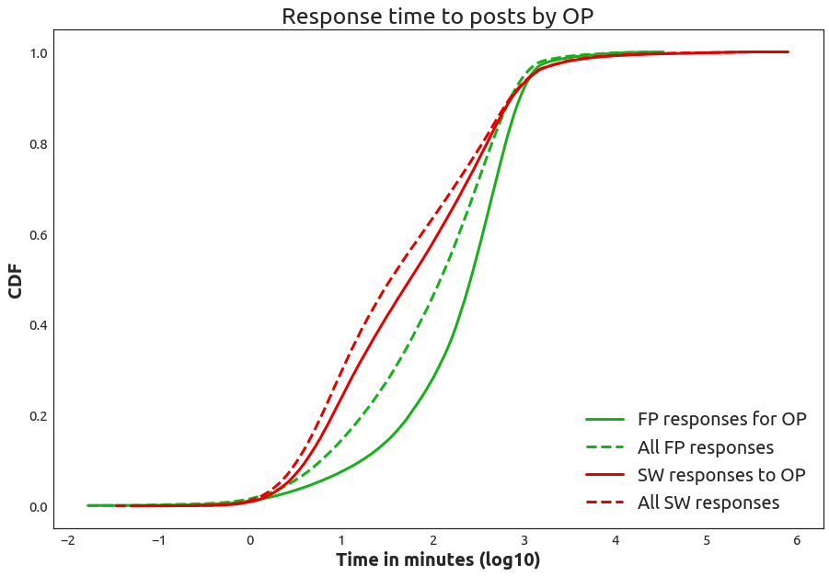

Slide 28
Metrics
Global structure metrics:
Centrality
Urgency
Rich clubs
Local structure metrics:
Anchored triads
Triadic closure
Semantic metrics:
Semantic alignment
Expertise Z-score

Slide 29
Data
Data
1 Million image comparisons
100k images
Additional 100k images acquired by using augmentation
Abstractions
Learnt abstractions of beauty using Deep learning and GANs

Slide 30
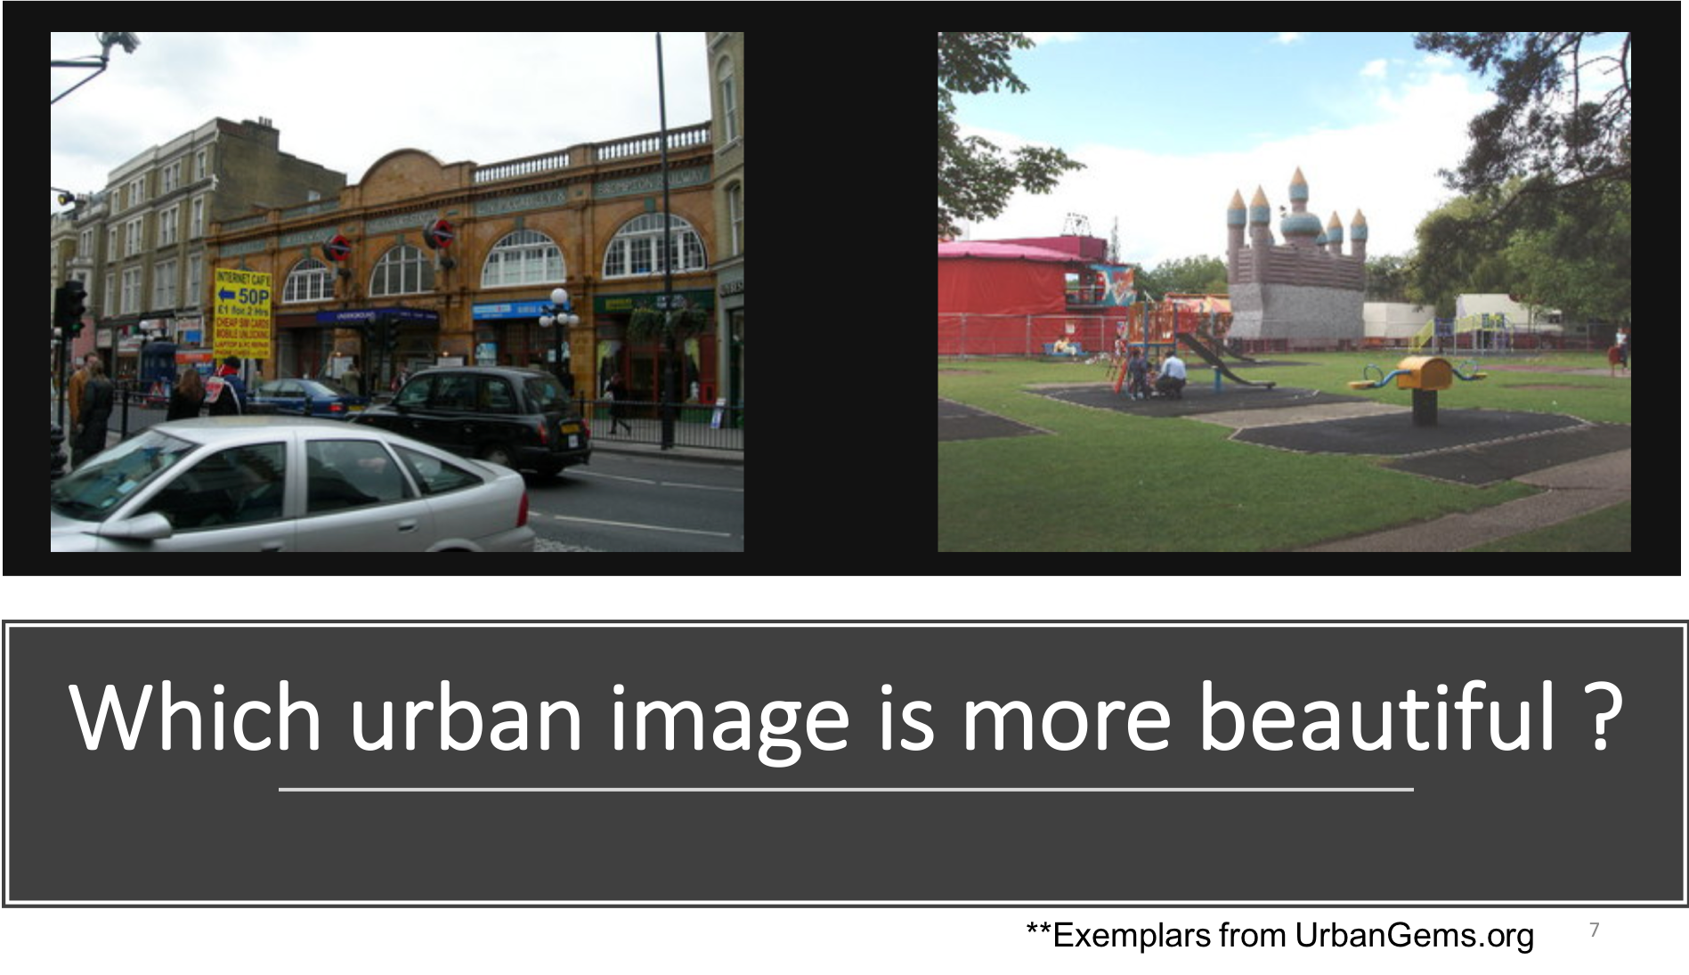

Slide 31
